Slide 1
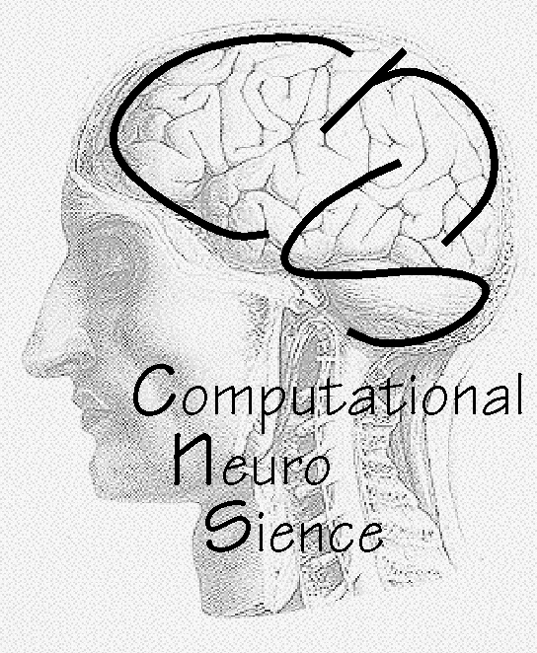
Basics of Computational Neuroscience

Slide 2

Topics:
Brain Science Background
General Computational Neuroscience Aspects
Learning, Plasticity and Behavioral Control of Autonomous Agents
I forgot to make a backup of my brain.
All what I had learned last term is gone now.

Slide 3
Lecture: Computational Neuroscience, Contents
The Basics – A reminder:
Introduction: Brain, Maps, Areas, Networks, Neurons, and Synapses
From Membrane Reactions to Information Extraction:
Membrane Models
Calculating with Neurons I: adding, subtracting, multiplying, dividing
Calculating with Neurons II: Integration
Information processing in the cortex I: Neurons as filters (Visual System)
Information processing in the cortex II: Correlations (auditory system)
Learning and Plasticity and the Link to Behavioral Control (animals and robots)
Introduction to Learning and Plasticity
Hebbian Learning and Stability – Additional more-stable Learning Rules
Applications of Hebb: PCA, Ocular dominance maps
Differential Hebbian Learning and Stability
Differential Hebbian Learning and its relation to STDP
Conditioning: Temporal Sequence Learning in Animals and Robots
Conditioning: Rescorla Wagner Rule
Conditioning and Reinforcement Learning: TD-Learning
Actor-Critic Architectures and the Basal Ganglia of the Brain
Reinforcement Learning for Control: Q and SARSA Learning
Self-Organization of Brain Structures („Maps in the Brain“)
Stranger Forms of Plasticity: Synaptic Scaling and Structural Plasticity

Slide 4
Literature (all of this is very mathematical!)
General Theoretical Neuroscience:
„Theoretical Neuroscience“, P.Dayan and L. Abbott, MIT Press (there used to be a version of this on the internet)
„Spiking Neuron Models“, W. Gerstner & W.M. Kistler, Cambridge University Press. (there is a version on the internet)
General Brain Science: „Principles of Neural Science“ E.R. Kandel, J.H. Schwartz, T.M. Jessel, et al. (McGraw Hill)

Slide 5
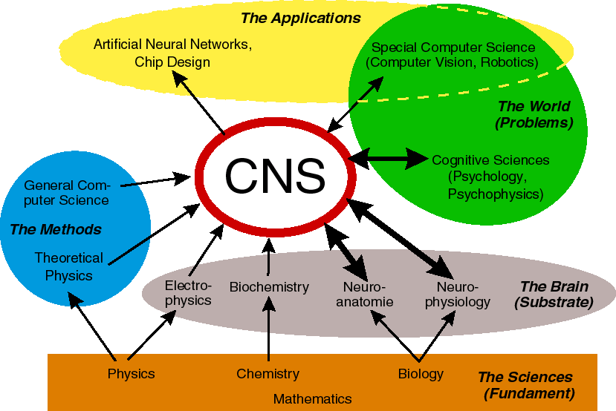
The Interdisciplinary Nature of Computational Neuroscience
What is computational neuroscience ?

Slide 6
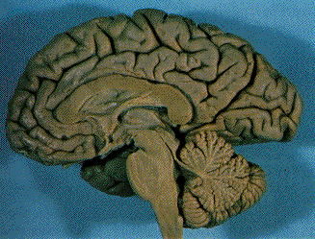
Neuroscience:
Different Approaches towards Brain and Behavior
Environment
Stimulus
Behavior
Reaction

Slide 7
Psychophysics (human behavioral studies):
Black Box
Environment
Stimulus
Behavior
Reaction

Slide 8
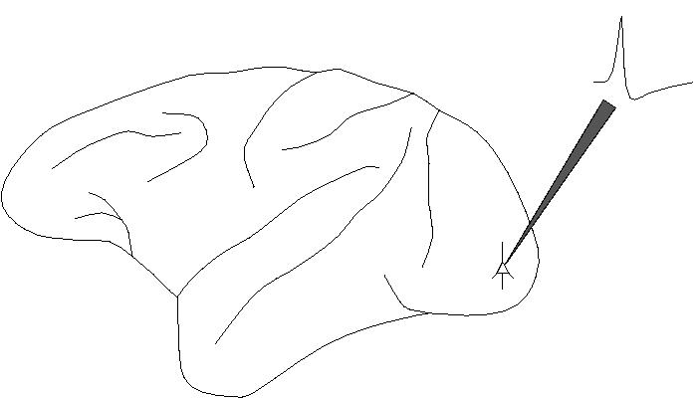
Neurophysiology:
Environment
Stimulus
Behavior
Reaction

Slide 9
Theoretical/Computational Neuroscience:
Environment
Stimulus
Behavior
Reaction

Slide 10
Levels of information processing in the nervous system
1m
CNS
10cm
Sub-Systems
1cm
Areas / „Maps“
1mm
Local Networks
100μm
Neurons
1μm
Synapses
0.1μm
Molecules

Slide 11
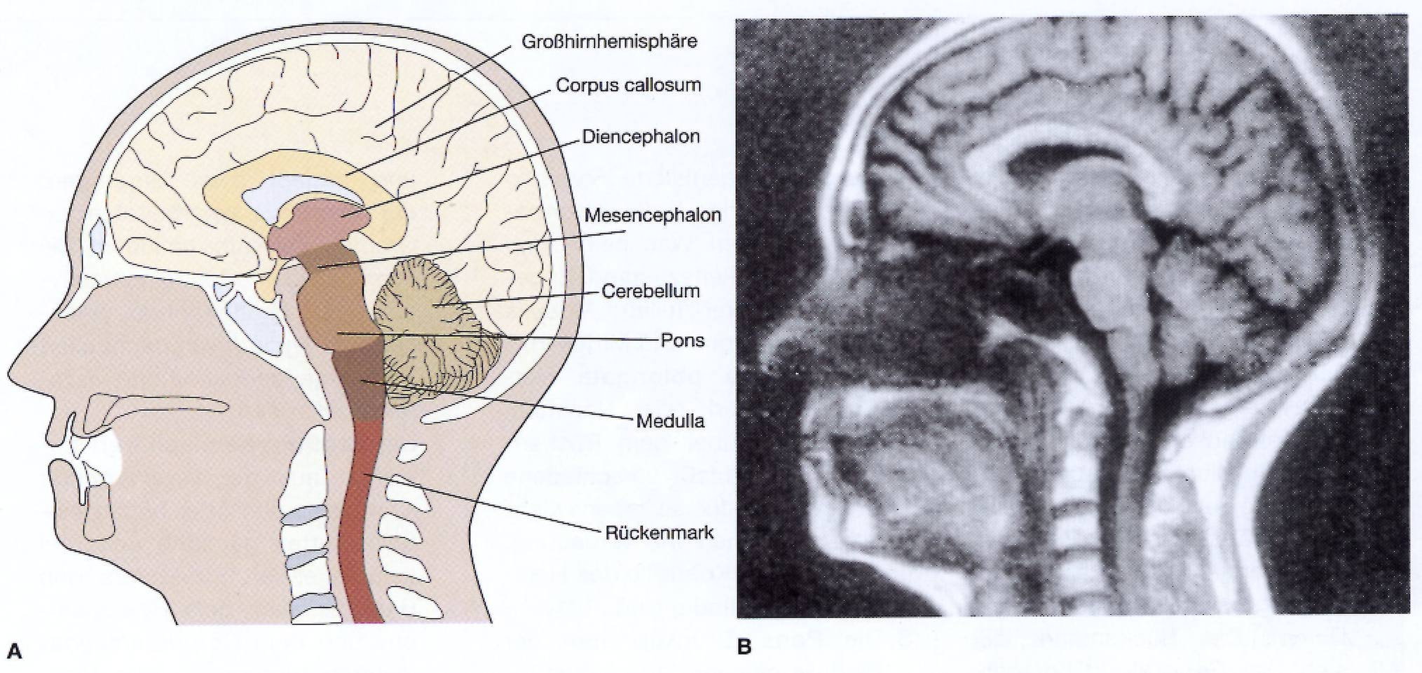
CNS (Central Nervous System):
CNS
Systems
Areas
Local Nets
Neurons
Synapses
Molekules

Slide 12
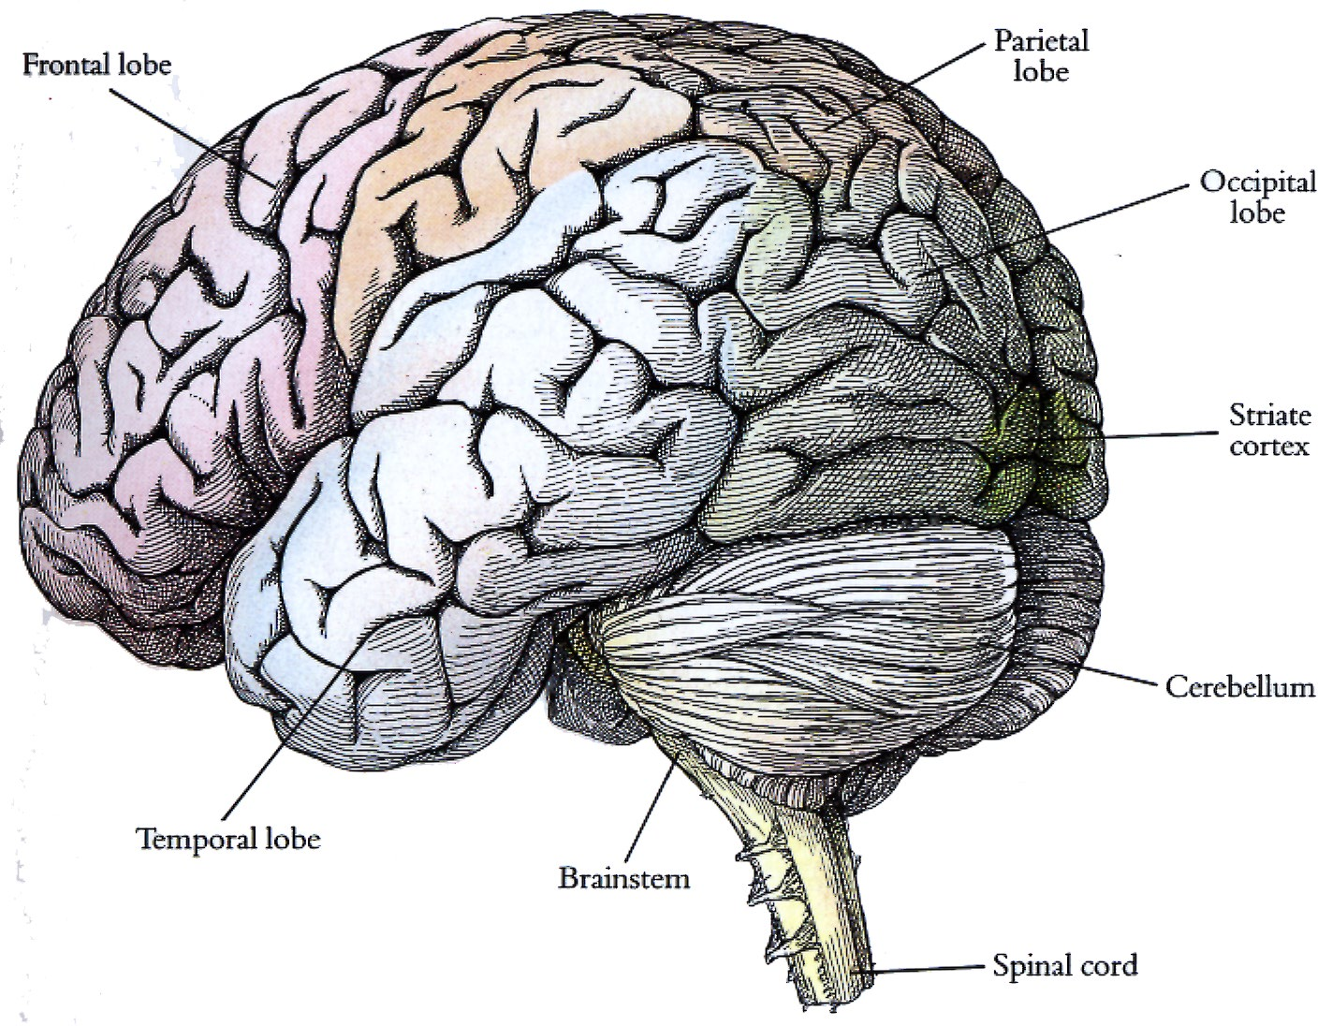
Cortex:
CNS
Systems
Areas
Local Nets
Neurons
Synapses
Molekules

Slide 13
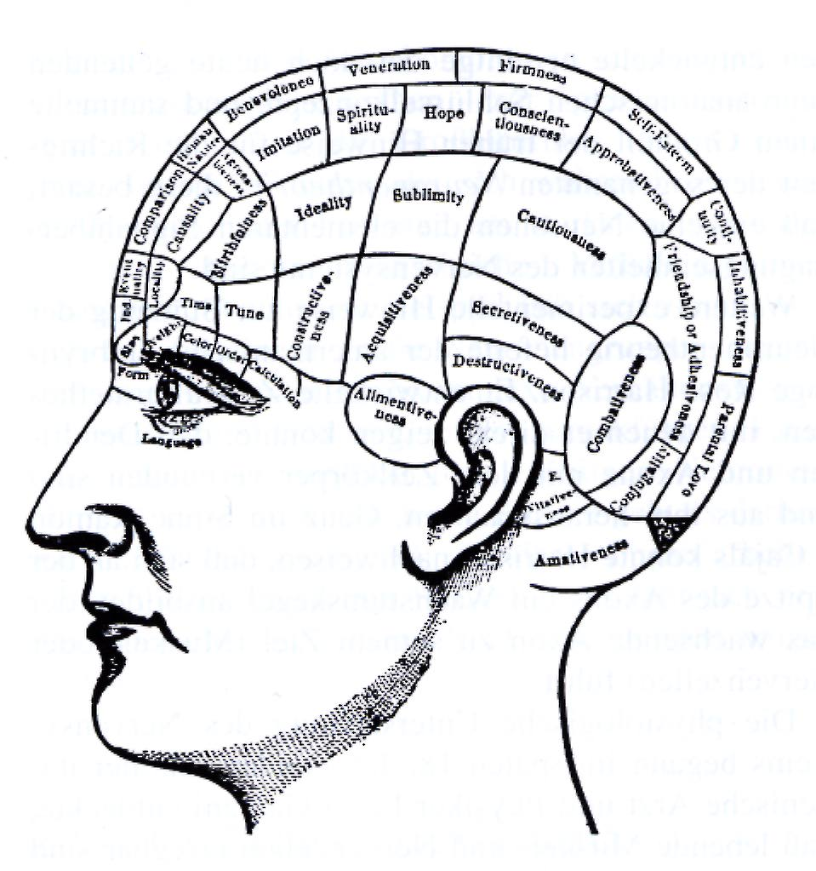
Where are things happening in the brain.
Is the information
represented locally ?
The Phrenologists view
at the brain
(18th-19th centrury)
CNS
Systems
Areas
Local Nets
Neurons
Synapses
Molekules

Slide 14
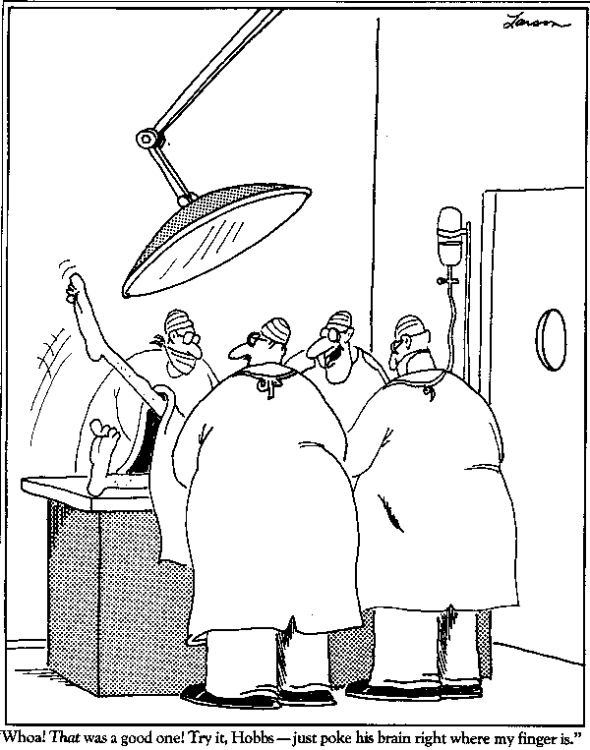
Results from human surgery
„Wowa! That was a good one! Try it, Hobbs – just poke his brain right where my finger is.“
CNS
Systems
Areas
Local Nets
Neurons
Synapses
Molekules

Slide 15
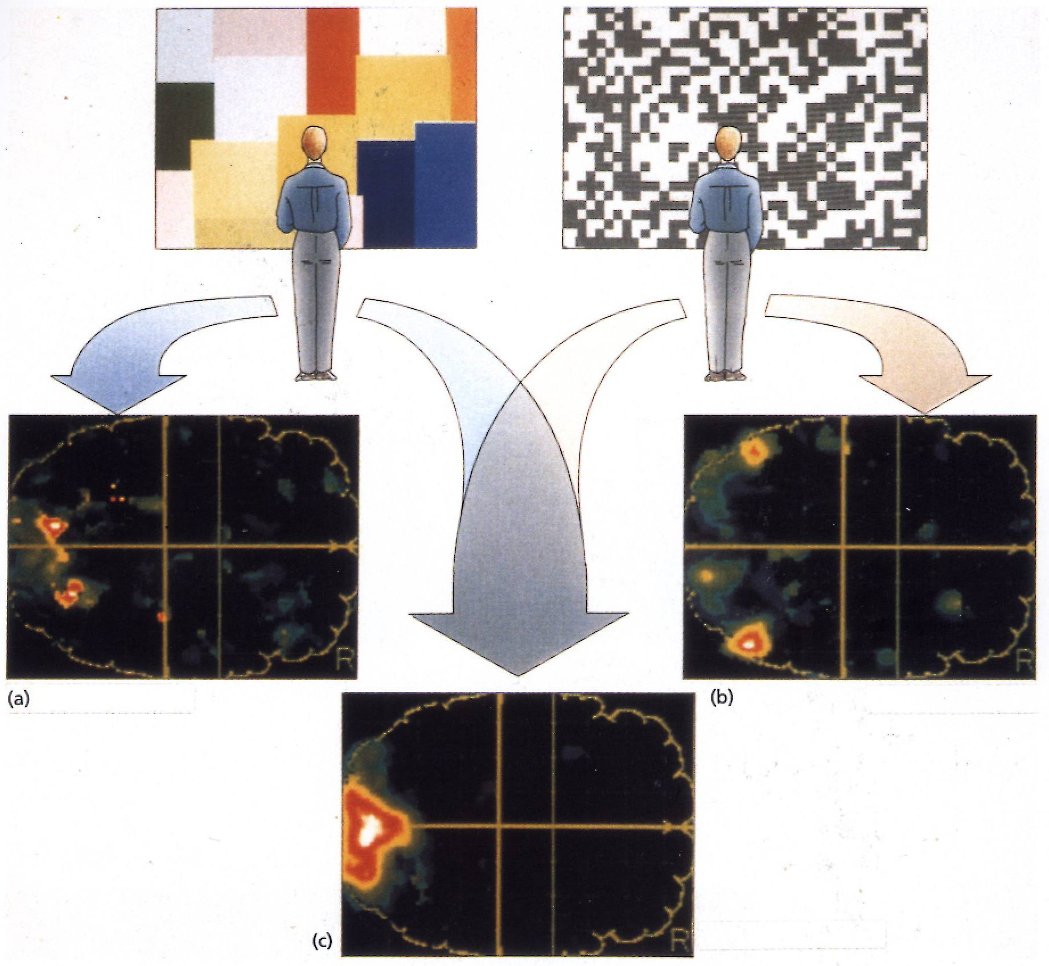
Results from imaging techniques – There are maps in the brain
CNS
Systems
Areas
Local Nets
Neurons
Synapses
Molekules

Slide 16
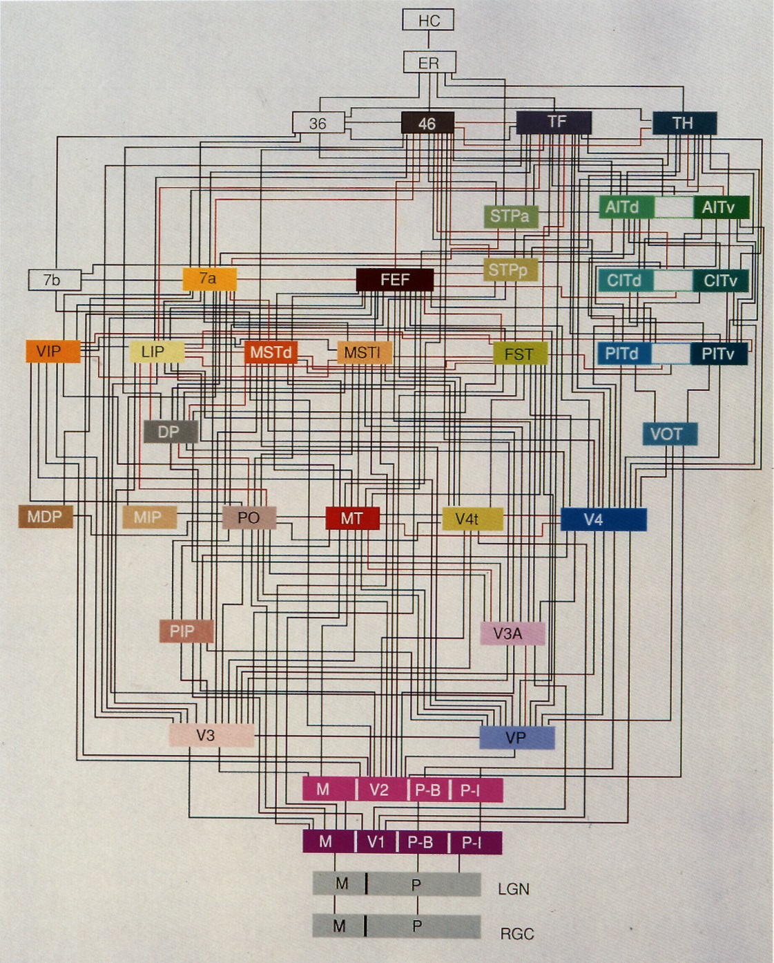
Visual System:
More than 40 areas !
Parallel processing of „pixels“ and
image parts
Hierarchical Analysis of increasingly complex information
Many lateral and feedback connections
Connectomics
CNS
Systems
Areas
Local Nets
Neurons
Synapses
Molekules

Slide 17
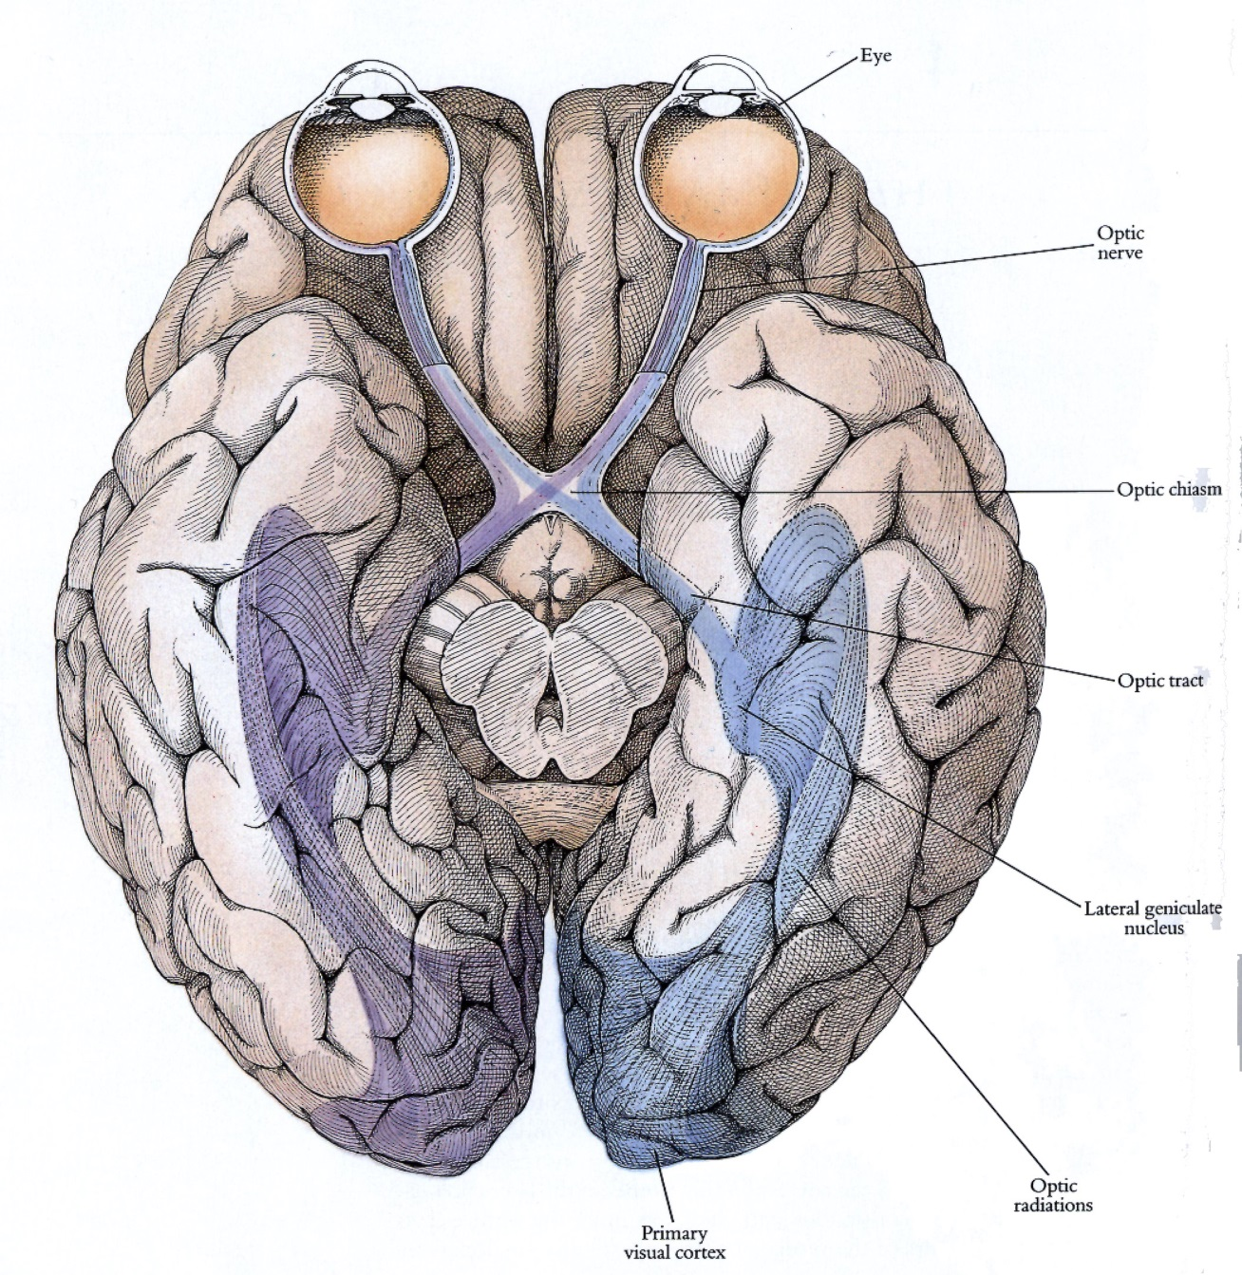
Primary visual Cortex:
CNS
Systems
Areas
Local Nets
Neurons
Synapses
Molekules

Slide 18
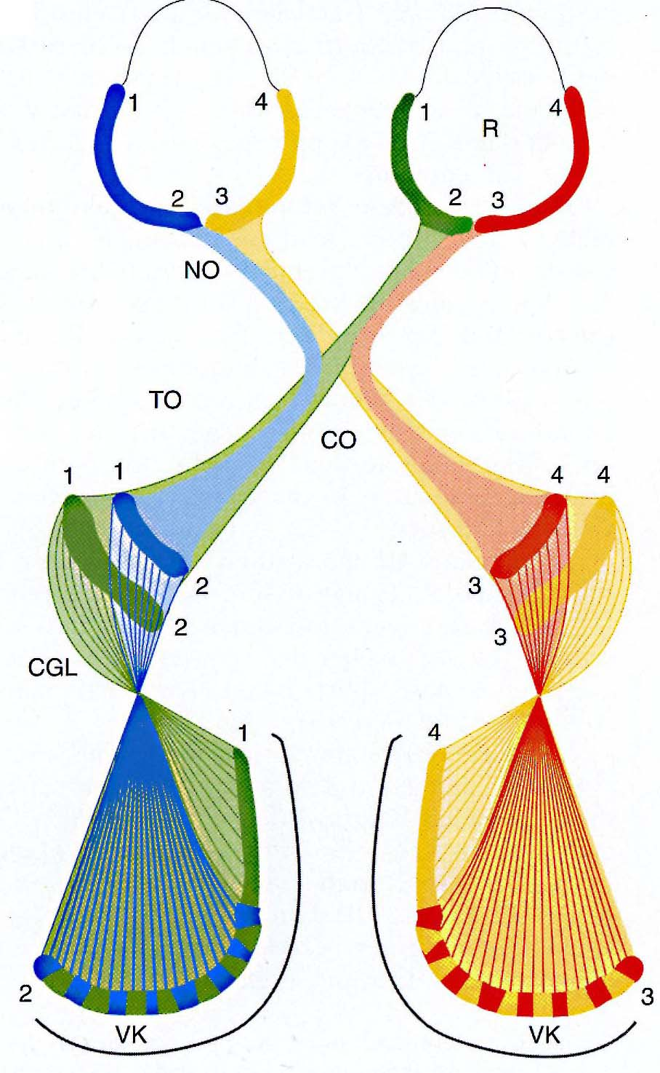
Retinotopic Maps in V1:
V1 contains a retinotopic map of the visual Field. Adjacent Neurons represent adjacent regions in the retina. That particular small retinal region from which a single neuron receives its input is called the receptive field of this neuron.
V1 receives information from both eyes. Alternating regions in V1 (Ocular Dominanz Columns) receive (predominantely) Input from either the left or the right eye.
Each location in the cortex represents a different part of the visual scene through the activity of many neurons. Different neurons encode different aspects of the image. For example, orientation of edges, color, motion speed and direction, etc.
V1 decomposes an image into these components.
CNS
Systems
Areas
Local Nets
Neurons
Synapses
Molekules

Slide 19
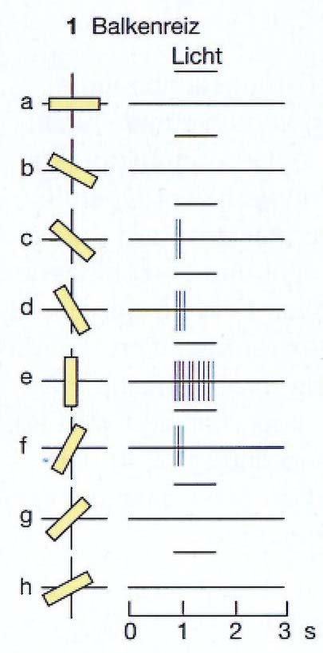
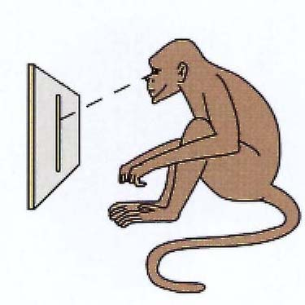
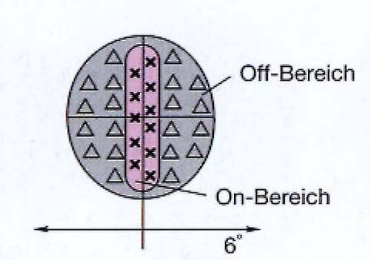
Orientation selectivity in V1:
stimulus
Orientation selective neurons in V1 change their activity (i.e., their frequency for generating action potentials) depending on the orientation of a light bar projected onto the receptive Field. These Neurons, thus, represent the orientation of lines oder edges in the image.
Their receptive field looks like this:
CNS
Systems
Areas
Local Nets
Neurons
Synapses
Molekules

Slide 20
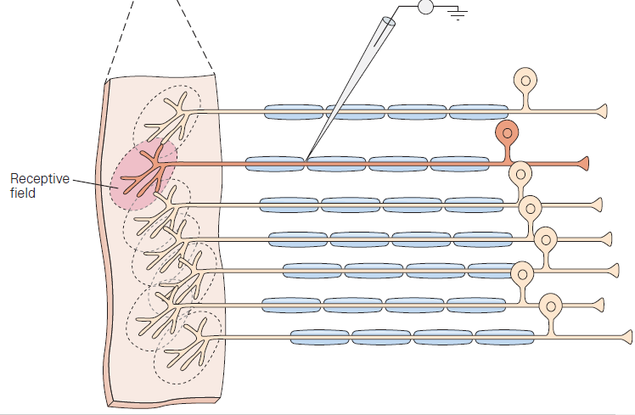
The concept of a receptive field
Receptive fields (of a sensory neuron):
... spatial domain in the sense organ (e.g. skin, eye) where stimulation
excites or inhibits the neuron
20
Kandel et al., 2000

Slide 21
The concept of a receptive field
21

Slide 22
Orientation selectivity in V1:
stimulus
Orientation selective neurons in V1 change their activity (i.e., their frequency for generating action potentials) depending on the orientation of a light bar projected onto the receptive Field. These Neurons, thus, represent the orientation of lines oder edges in the image.
Their receptive field looks like this:
CNS
Systems
Areas
Local Nets
Neurons
Synapses
Molekules

Slide 23
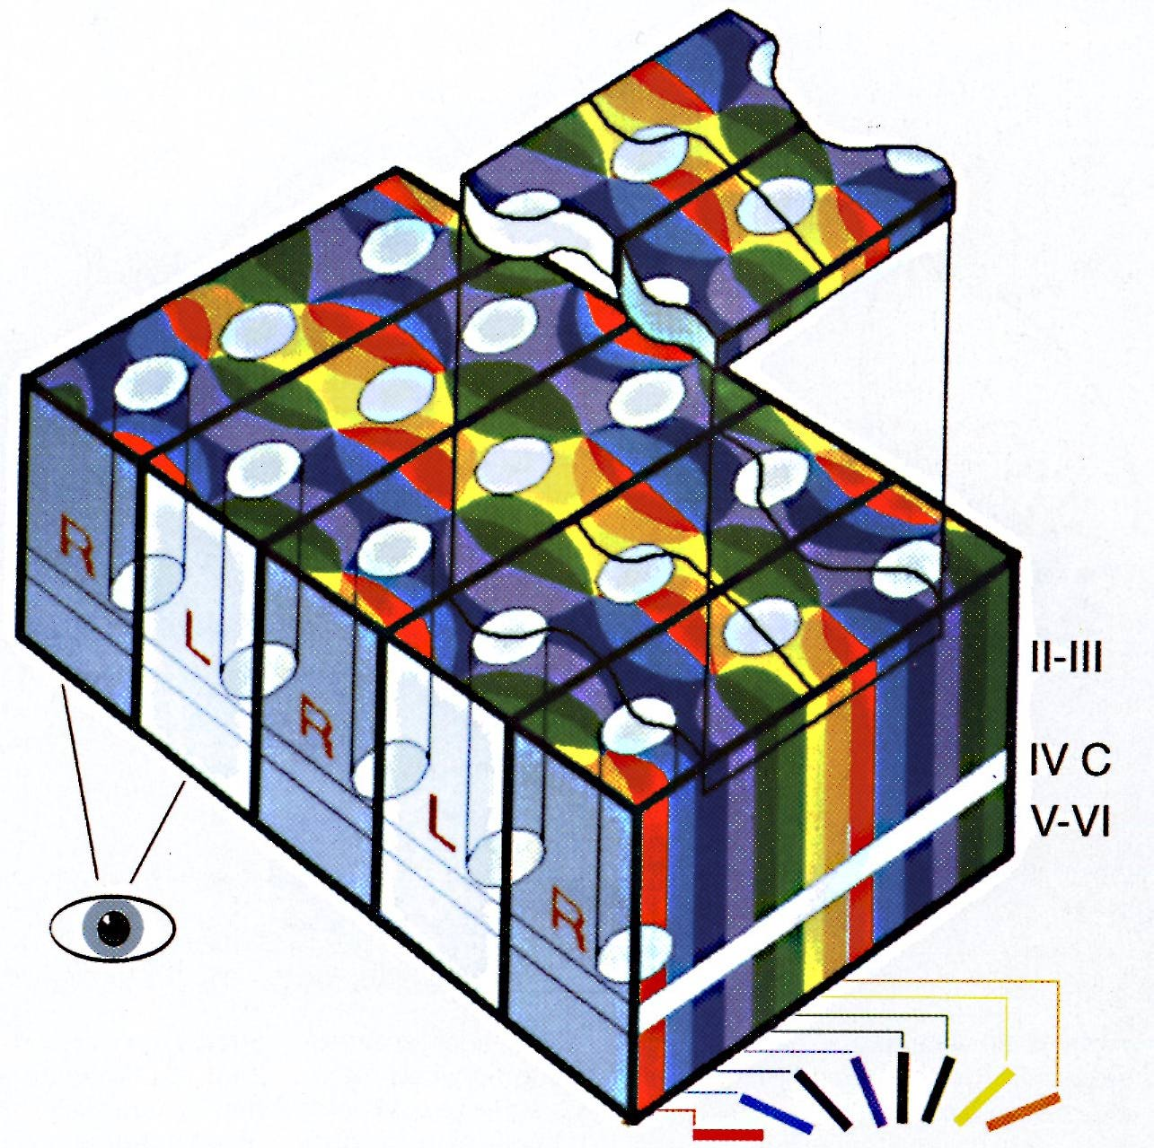
Superpositioning of maps in V1:
Thus, neurons in V1 are orientation selective. They are, however, also selective for retinal position and ocular dominance as well as for color and motion. These are called „features“. The neurons are therefore akin to „feature-detectors“.
For each of these parameter there exists a topographic map.
These maps co-exist and are superimposed onto each other. In this way at every location in the cortex one finds a neuron which encodes a certain „feature“. This principle is called „full coverage“.
CNS
Systems
Areas
Local Nets
Neurons
Synapses
Molekules

Slide 24
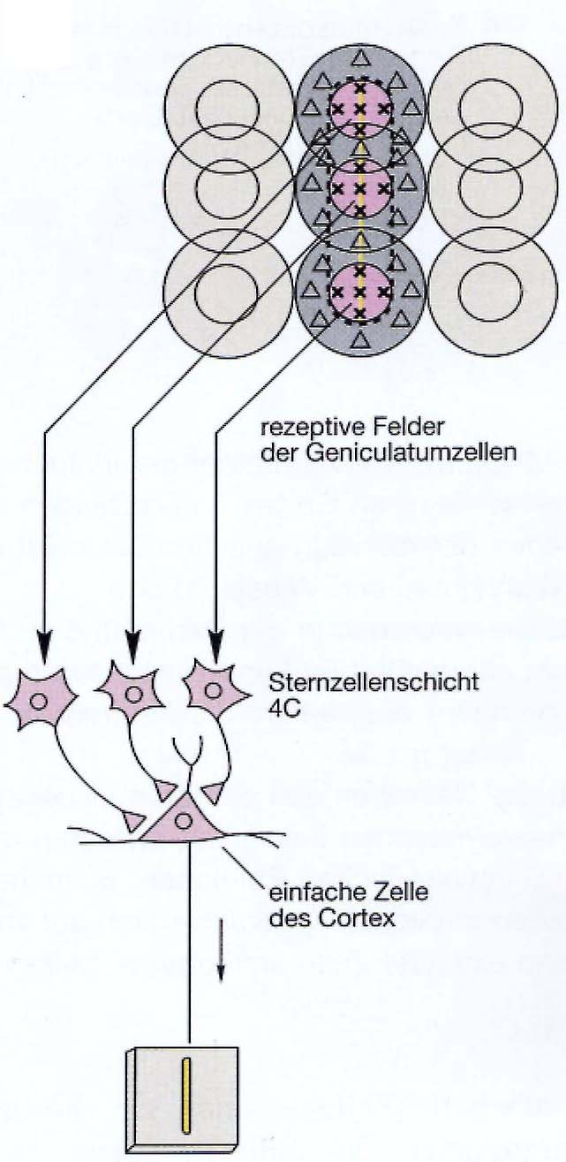
Local Circuits in V1:
stimulus
Selectivity is generated by specific connections
Orientation selective
cortical simple cell
CNS
Systems
Areas
Local Nets
Neurons
Synapses
Molekules

Slide 25
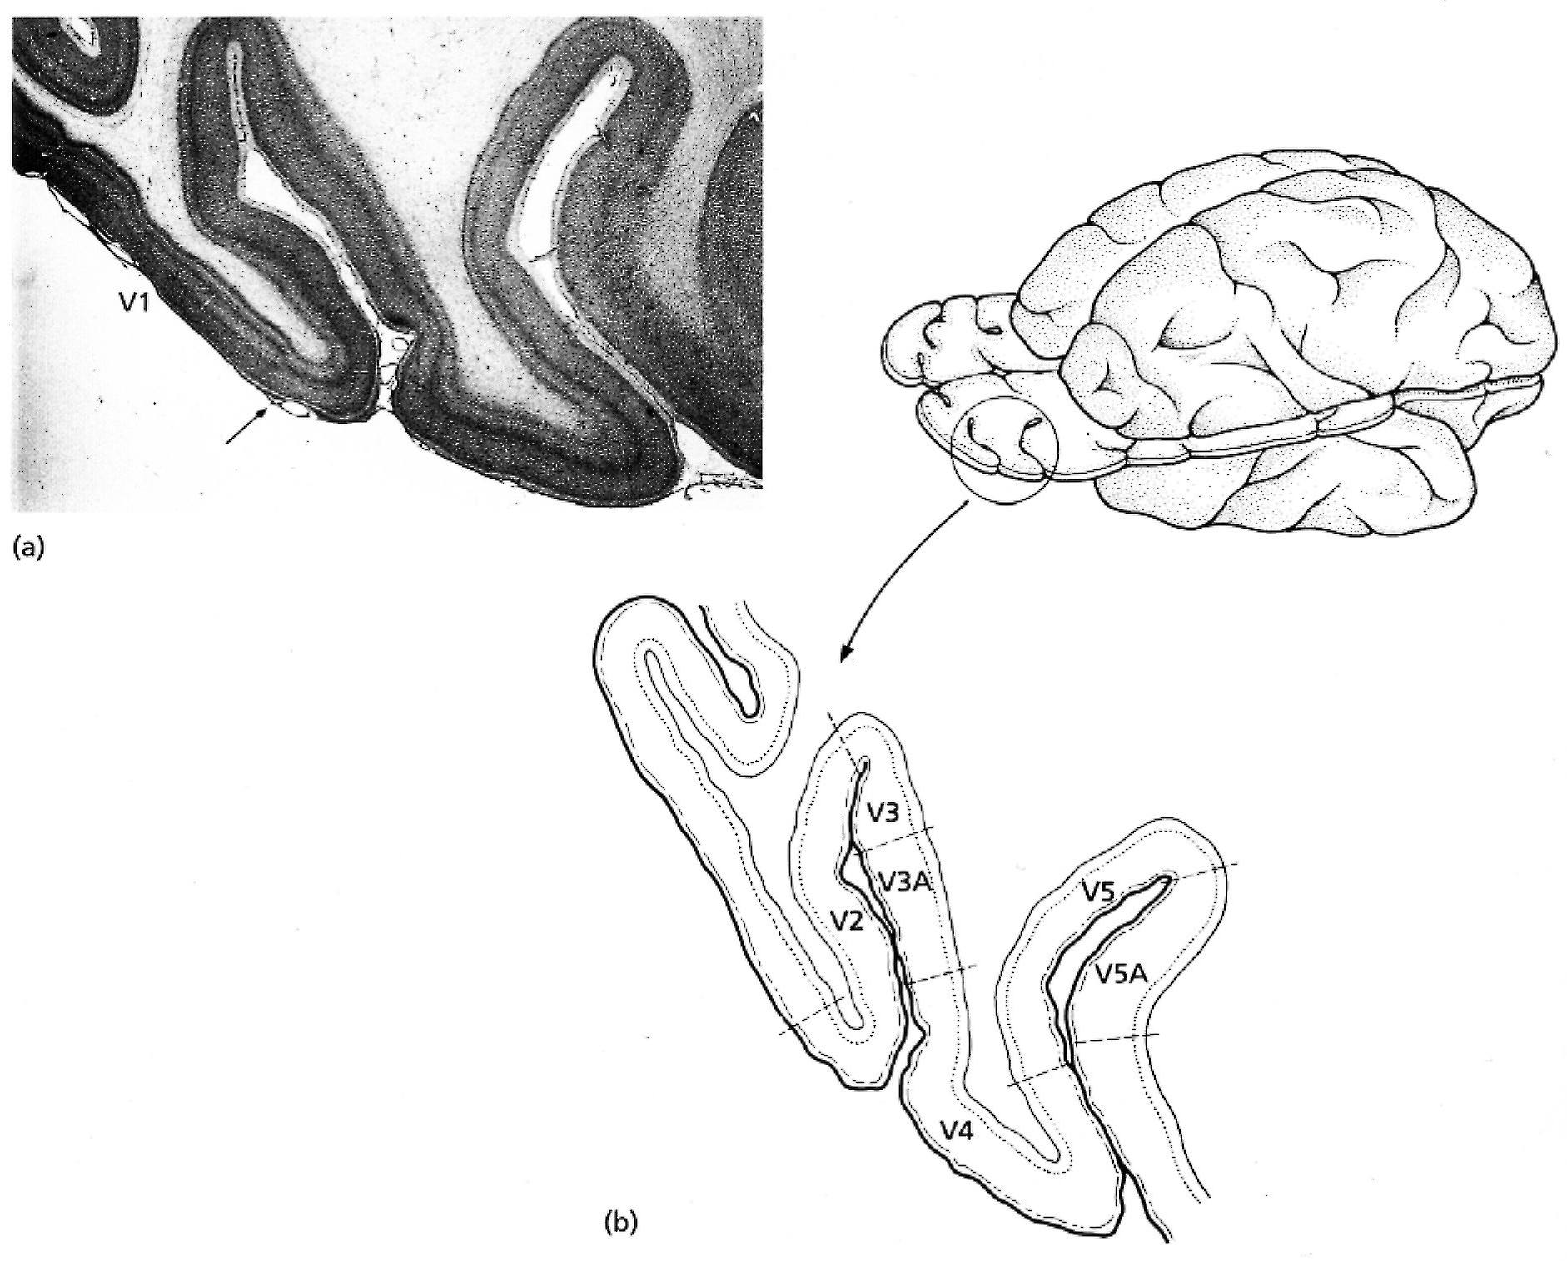
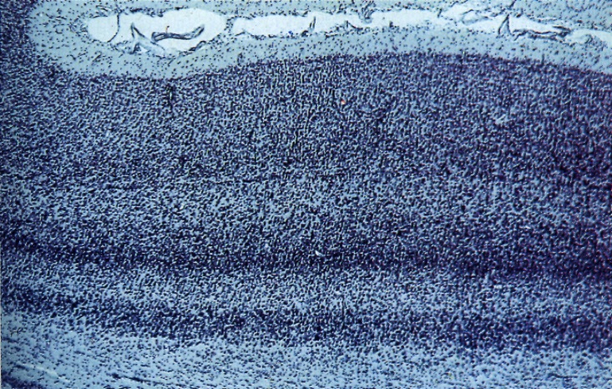
Layers in the Cortex:
White matter
V1
CNS
Systems
Areas
top
Local Nets
Neurons
Synapses
Molekules

Slide 26
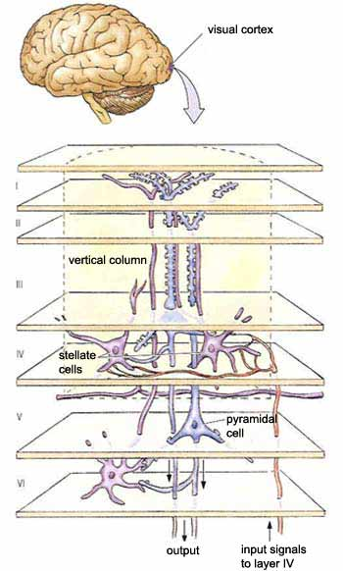
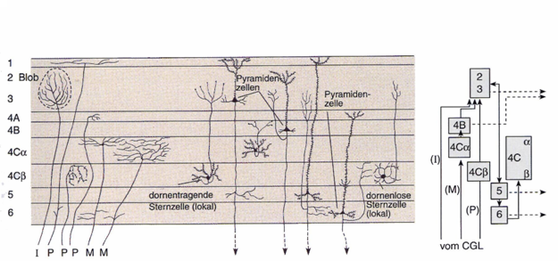
Local Circuits in V1:
CNS
Systems
Areas
Local Nets
Neurons
Synapses
Molekules
LGN inputs
Cell types
Circuit
Spiny stellate
cell
Smooth stellate
cell

Slide 27
Considerations for a Cortex Model
Input
Structure of the visual pathway
Anatomy of the Cortex
Cell Types
Connections
Topography of the Cortex
„X-Y Pixel-Space“ and its distortion
Ocularity-Map
Orientation-Map
Color
Functional Connectivity of the cortex
Connection Weights
Physiological charateristics of the neurons
At least all these things need to be considered when making a „complete“ cortex model

Slide 28
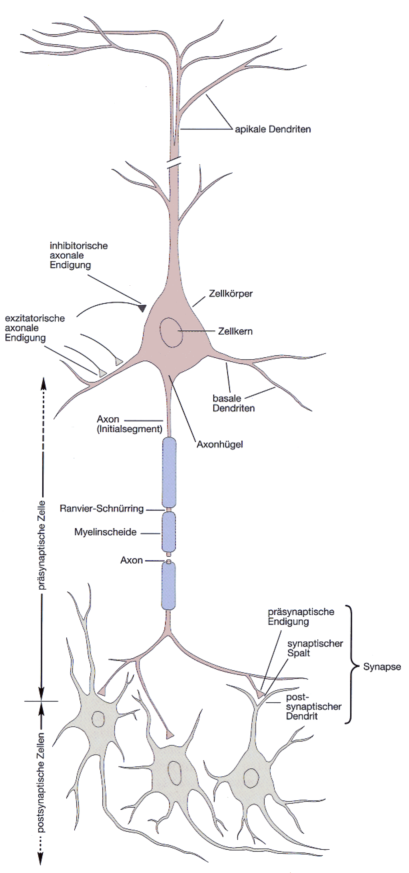
Structure of a Neuron:
At the dendrite the incoming
signals arrive (incoming currents)
At the soma current
are finally integrated.
At the axon hillock action potential
are generated if the potential crosses the
membrane threshold
The axon transmits (transports) the
action potential to distant sites
CNS
At the synapses are the outgoing
signals transmitted onto the
dendrites of the target
neurons
Systems
Areas
Local Nets
Neurons
Synapses
Molekules

Slide 29
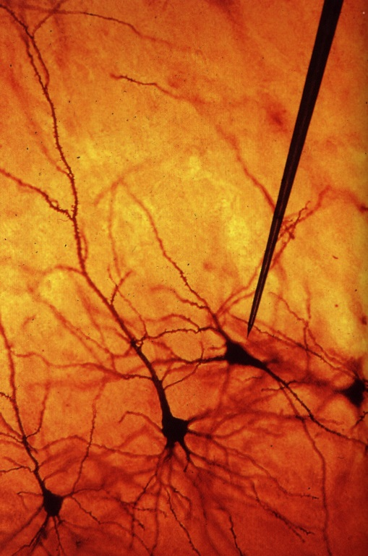
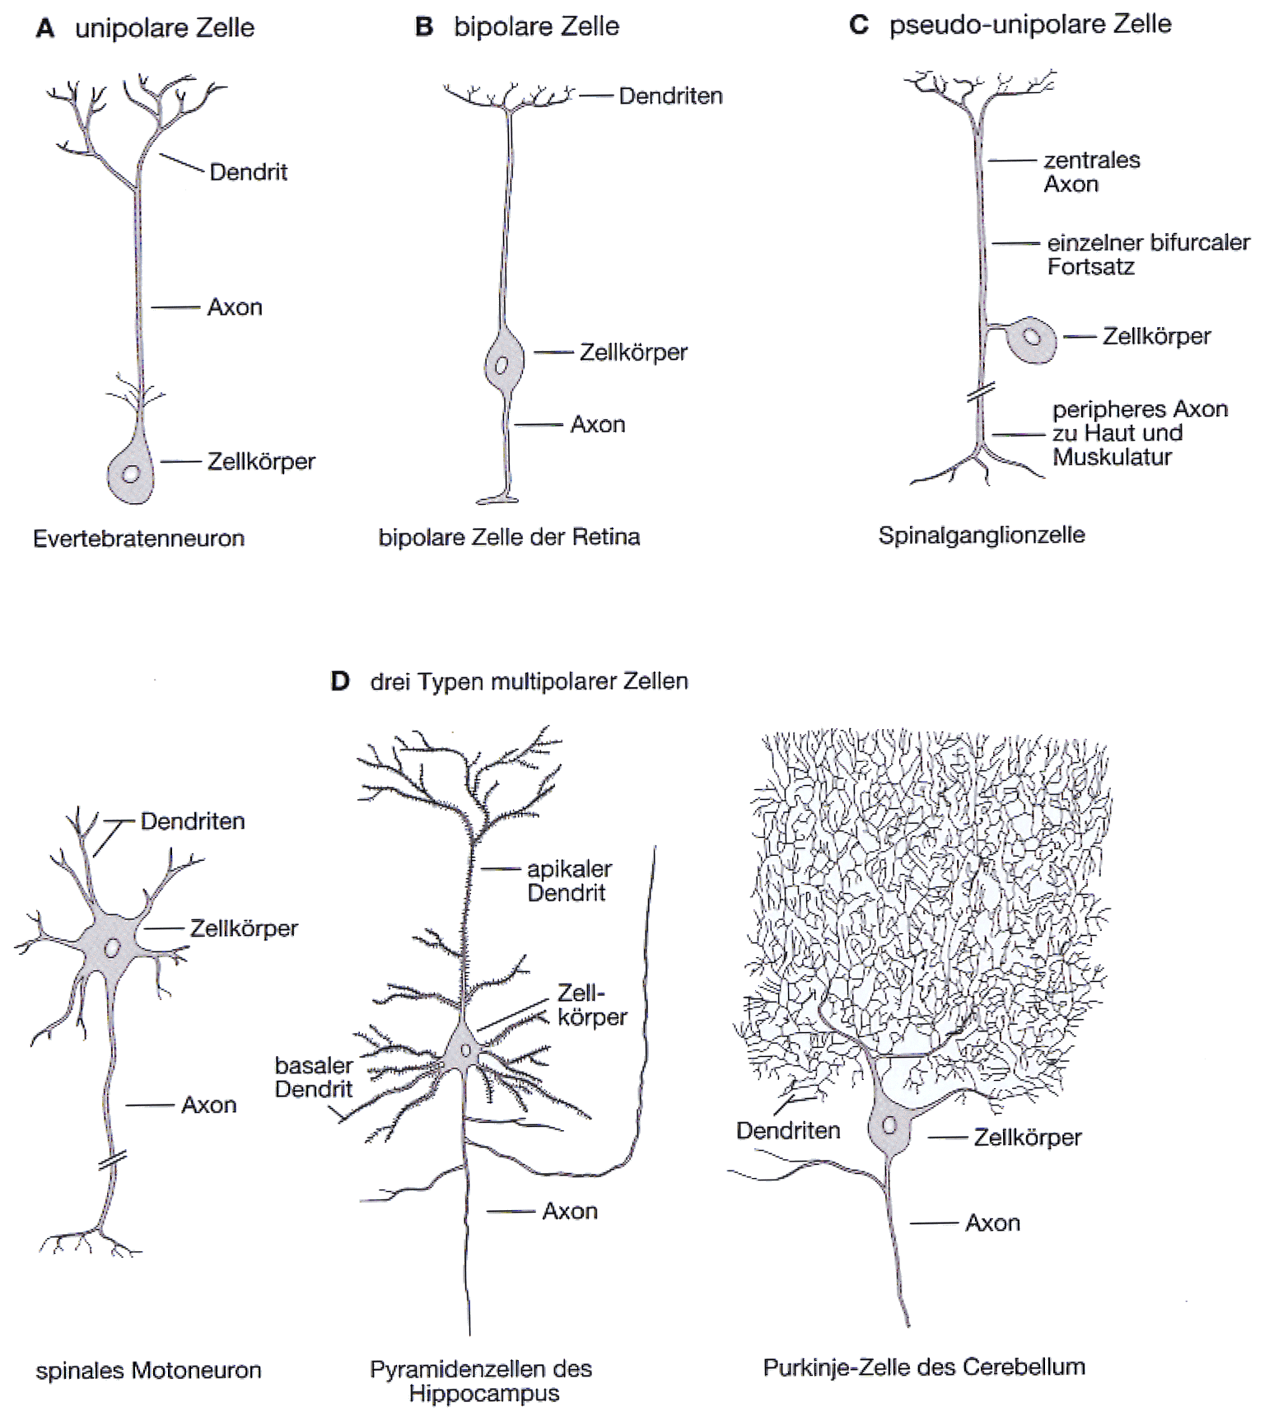
Different Types of Neurons:
dendrite
dendrite
Unipolar
cell
axon
Bipolar
cell
soma
axon
soma
(Invertebrate N.)
Retinal bipolar cell
Real Pyramidal Cells
Different Types
of Multi-polar
Cells
Hippocampal
pyramidal cell
Purkinje cell of the
cerebellum
Spinal motoneuron

Slide 30
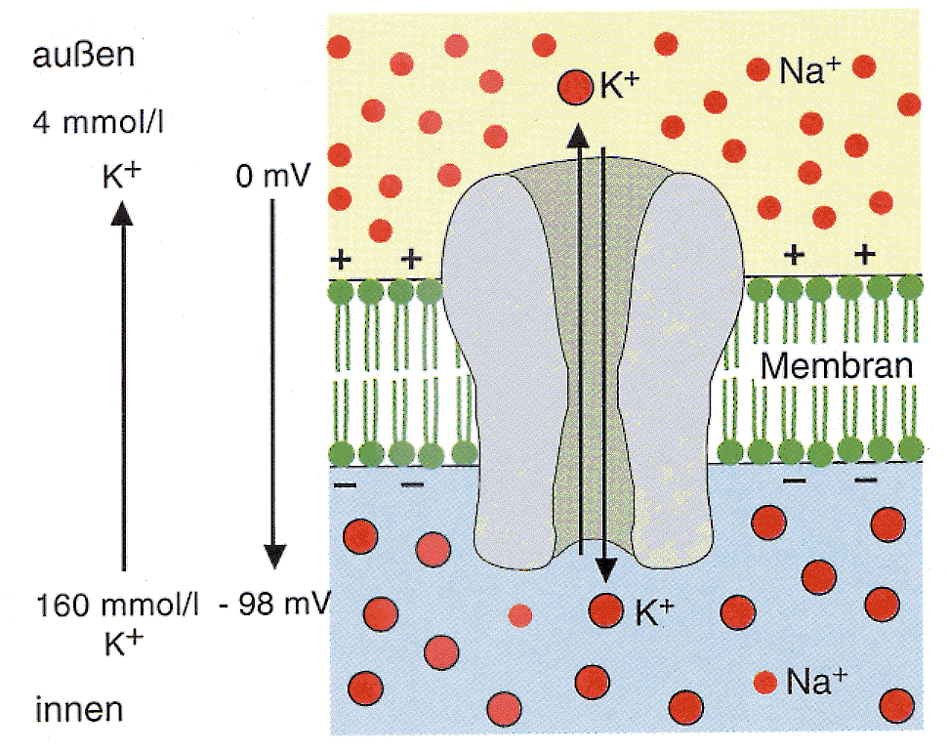
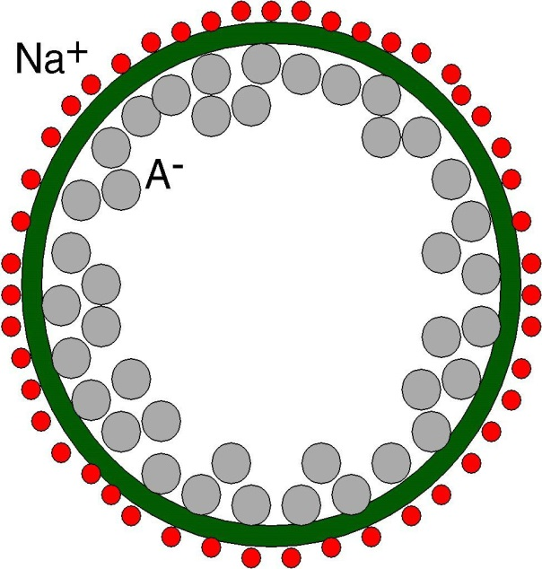
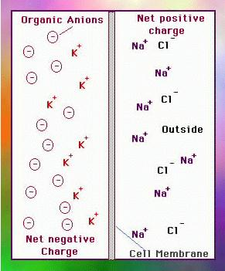
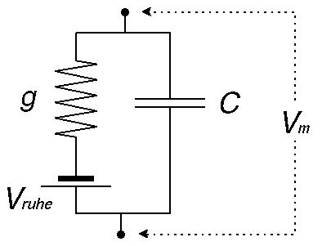
Cell membrane:
Ion channels:
Cl⁻
K⁺
Membrane - Circuit diagram:
rest

Slide 31
Structure of a Neuron:
At the dendrite the incoming
signals arrive (incoming currents)
At the soma current
are finally integrated.
At the axon hillock action potential
are generated if the potential crosses the membrane threshold
The axon transmits (transports) the
action potential to distant sites
At the synapses are the outgoing
signals transmitted onto the
dendrites of the target neurons

Slide 32
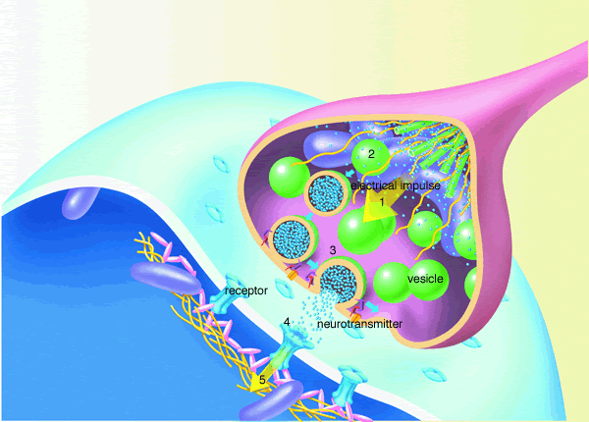
Schematic Diagram of a Synapse
Receptor ≈ Channel
Transmitter
Terms to remember !

Slide 33
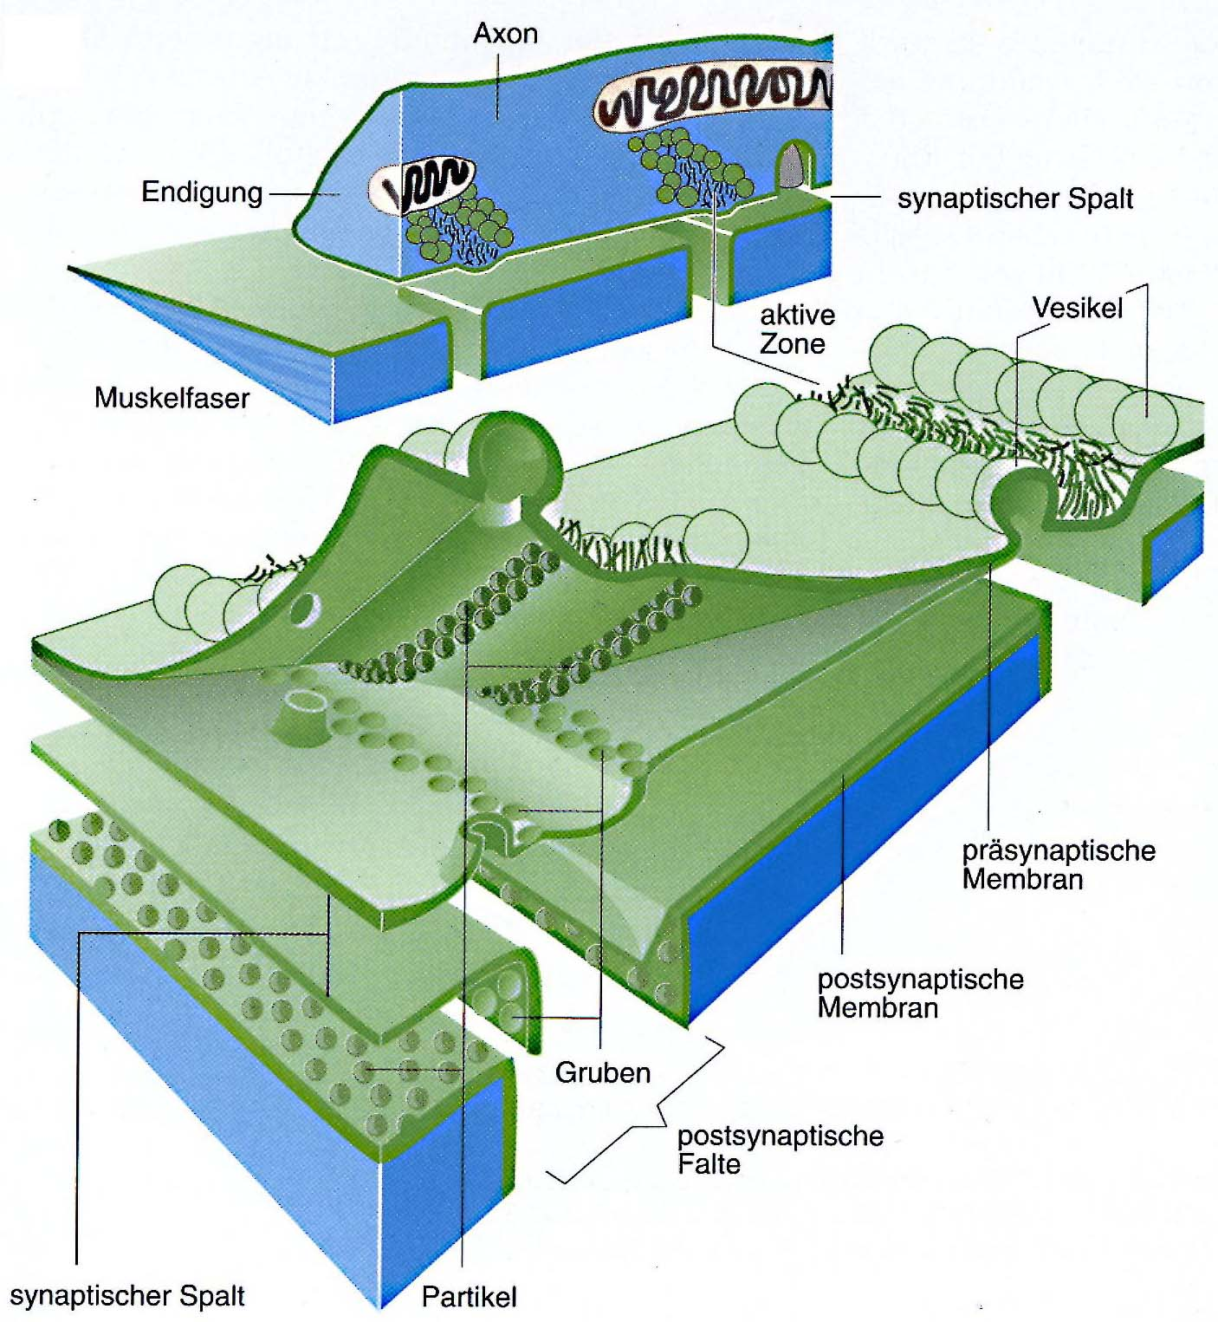
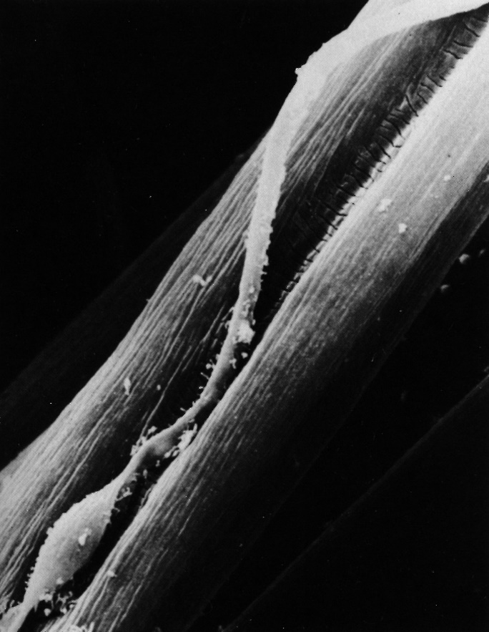
Structure of a Chemical Synapse:
Axon
Motor Endplate
(Frog muscle)
Synaptic cleft
Active
zone
vesicles
Muscle fiber
Presynaptic
membrane
Postsynaptic
membrane
Synaptic cleft

Slide 34
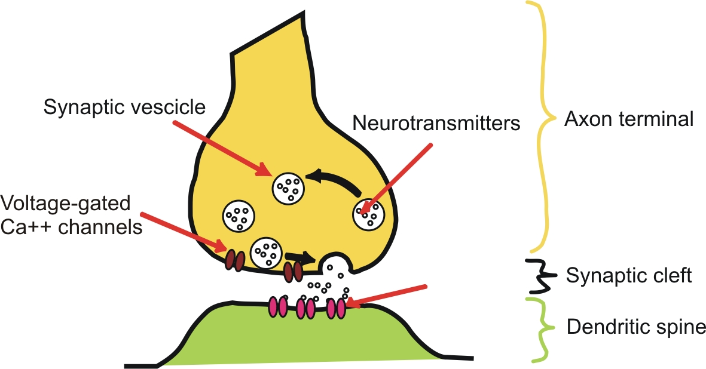
Chemical synapse
Neurotransmitter
Receptors

Slide 35
Neurotransmitters
Chemicals (amino acids, peptides, monoamines) that transmit, amplify and modulate signals between neuron and another cell.
Cause either excitatory or inhibitory potentials (“PSPs”).

Slide 36
Some neurotransmitters and their (main and – alas – nonunique) Actions:
Transmitter Channel-typ Ion-current Action
Transmitter Channel-typ Ion-current Action
Acetylecholin nicotin. Receptor Na⁺ and K⁺ excitatory
Transmitter Channel-typ Ion-current Action
Acetylecholin nicotin. Receptor Na⁺ and K⁺ excitatory
Glutamate AMPA / Kainate Na⁺ and K⁺ excitatory
Transmitter Channel-typ Ion-current Action
Acetylecholin nicotin. Receptor Na⁺ and K⁺ excitatory
Glutamate AMPA / Kainate Na⁺ and K⁺ excitatory
GABA GABA_{A}-Receptor Cl⁻ inhibitory
Transmitter Channel-typ Ion-current Action
Acetylecholin nicotin. Receptor Na⁺ and K⁺ excitatory
Glutamate AMPA / Kainate Na⁺ and K⁺ excitatory
GABA GABA_{A}-Receptor Cl⁻ inhibitory
Glycine Cl⁻ inhibitory
Transmitter Channel-typ Ion-current Action
Acetylecholin nicotin. Receptor Na⁺ and K⁺ excitatory
Glutamate AMPA / Kainate Na⁺ and K⁺ excitatory
GABA GABA_{A}-Receptor Cl⁻ inhibitory
Glycine Cl⁻ inhibitory
Acetylecholin muscarin. Rec. - metabotropic, Ca²⁺ Release
Transmitter Channel-typ Ion-current Action
Acetylecholin nicotin. Receptor Na⁺ and K⁺ excitatory
Glutamate AMPA / Kainate Na⁺ and K⁺ excitatory
GABA GABA_{A}-Receptor Cl⁻ inhibitory
Glycine Cl⁻ inhibitory
Acetylecholin muscarin. Rec. - metabotropic, Ca²⁺ Release
Glutamate NMDA Na⁺, K⁺, Ca²⁺ voltage dependent
blocked at resting potential

Slide 37
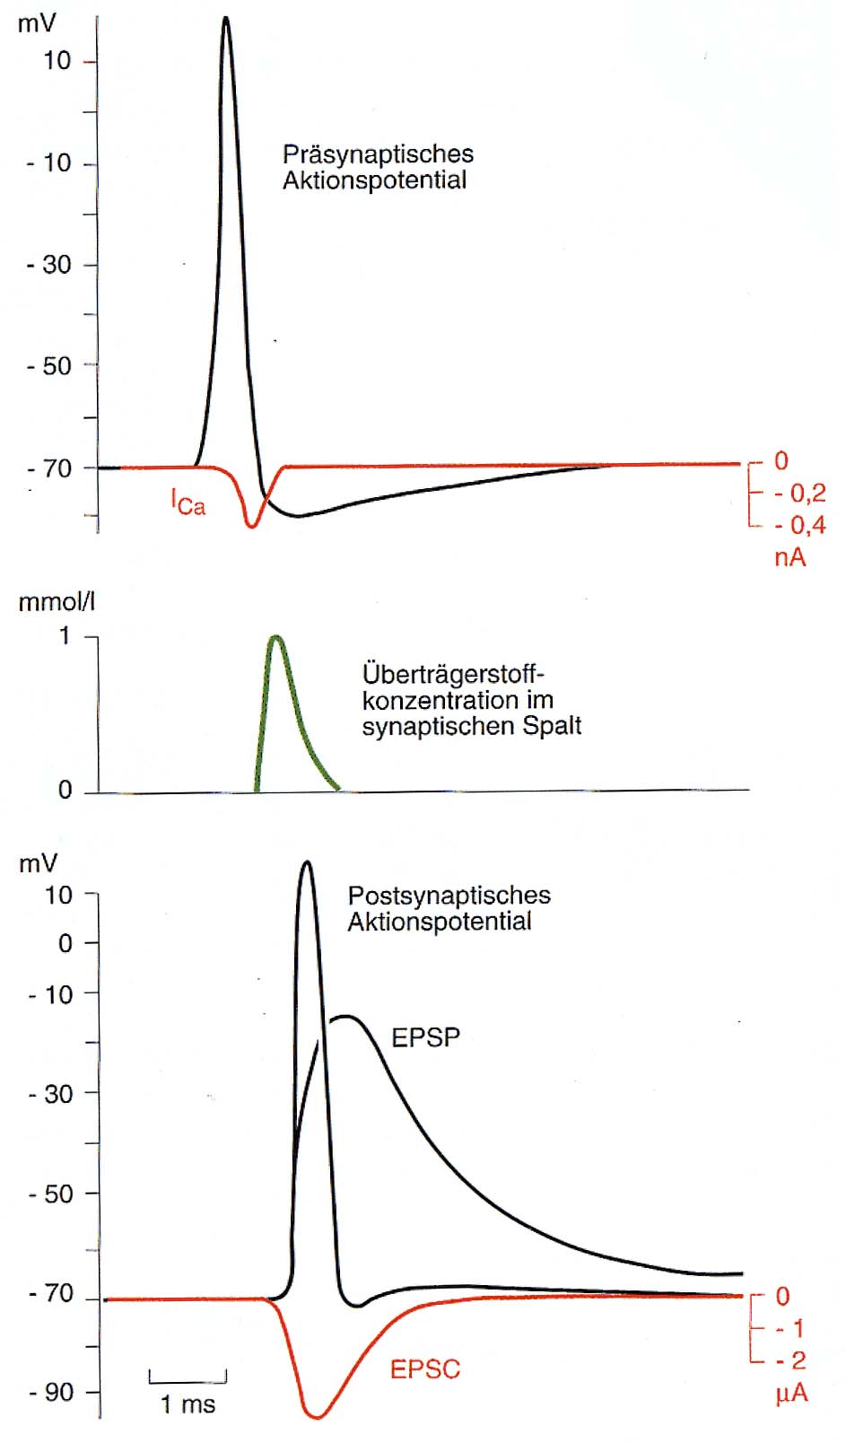
What happens at a chemical synapse during signal transmission:
The pre-synaptic action potential depolarises the axon terminals and Ca²⁺-channels open.
The pre-synaptic action potential depolarises the axon terminals and Ca²⁺-channels open.
Ca²⁺ enters the pre-synaptic cell by which the transmitter vesicles are forced to open and release the transmitter.
The pre-synaptic action potential depolarises the axon terminals and Ca²⁺-channels open.
Ca²⁺ enters the pre-synaptic cell by which the transmitter vesicles are forced to open and release the transmitter.
Thereby the concentration of transmitter increases in the synaptic cleft and transmitter diffuses to the postsynaptic membrane.
The pre-synaptic action potential depolarises the axon terminals and Ca²⁺-channels open.
Ca²⁺ enters the pre-synaptic cell by which the transmitter vesicles are forced to open and release the transmitter.
Thereby the concentration of transmitter increases in the synaptic cleft and transmitter diffuses to the postsynaptic membrane.
Transmitter sensitive channels at the postsyaptic membrane open. Na⁺ and Ca²⁺ enter, K⁺ leaves the cell. An excitatory postsynaptic current (EPSC) is thereby generated which leads to an excitatory postsynaptic potential (EPSP).
Pre-synaptic
action potential
Concentration of
transmitter
in the synaptic cleft
Post-synaptic
action potential
5 mV

Slide 38
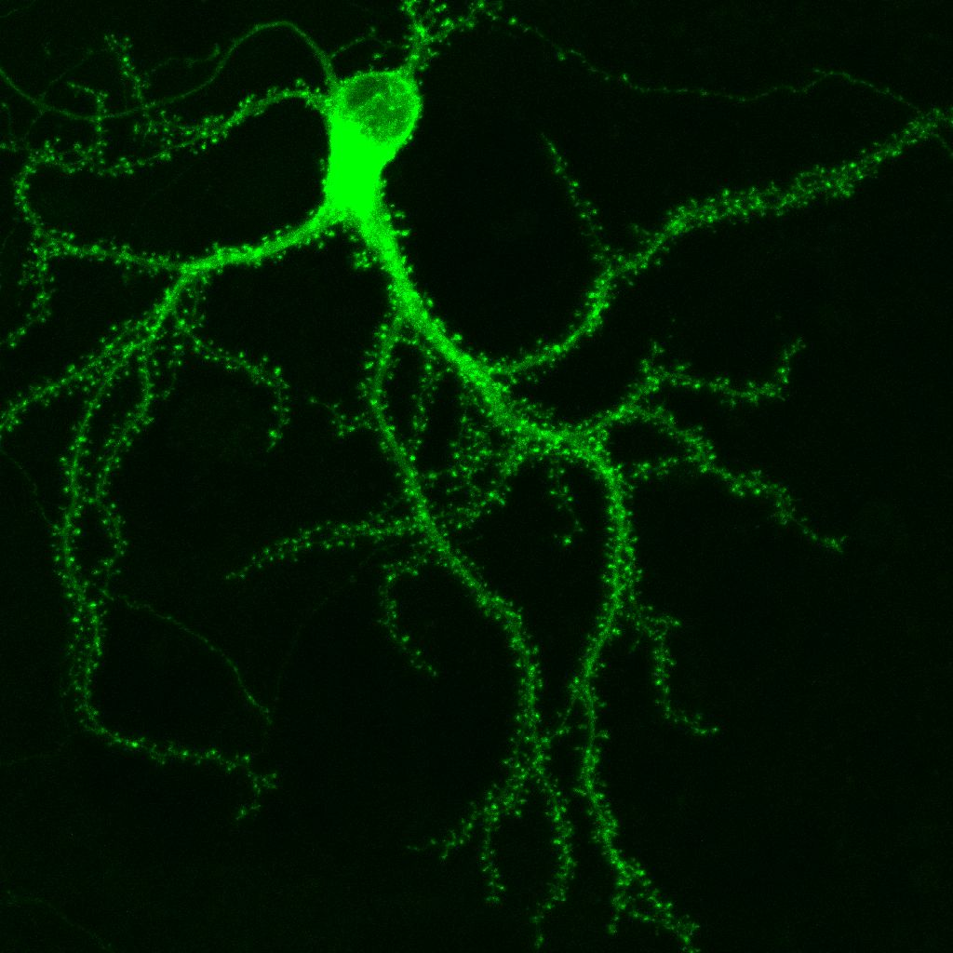
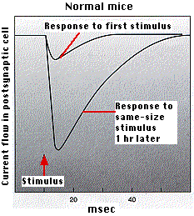
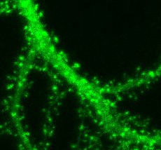
Information is stored in a Neural Network by the Strength
of its Synaptic Connections
Growth or new
generation of
contact points
Contact points
(syn. Spines)
for other
neurons
Up to 10000 Synapses
per Neuron

Slide 39
Synaptic Transmission (additional aspects):
Synapses are used to transmit signals from the axon of a source to the dendrite of a target neuron.
Synapses are used to transmit signals from the axon of a source to the dendrite of a target neuron.
There are electrical (rare) and chemical synapses (very common)
Synapses are used to transmit signals from the axon of a source to the dendrite of a target neuron.
There are electrical (rare) and chemical synapses (very common)
At an electrical synapse we have direct electrical coupling (e.g., heart muscle cells).
Synapses are used to transmit signals from the axon of a source to the dendrite of a target neuron.
There are electrical (rare) and chemical synapses (very common)
At an electrical synapse we have direct electrical coupling (e.g., heart muscle cells).
At a chemical synapse a chemical substance (transmitter) is used to transport the signal.
Synapses are used to transmit signals from the axon of a source to the dendrite of a target neuron.
There are electrical (rare) and chemical synapses (very common)
At an electrical synapse we have direct electrical coupling (e.g., heart muscle cells).
At a chemical synapse a chemical substance (transmitter) is used to transport the signal.
Electrical synapses operate bi-directional and are extremely fast, chem. syn. operate uni-directional and are slower.
Synapses are used to transmit signals from the axon of a source to the dendrite of a target neuron.
There are electrical (rare) and chemical synapses (very common)
At an electrical synapse we have direct electrical coupling (e.g., heart muscle cells).
At a chemical synapse a chemical substance (transmitter) is used to transport the signal.
Electrical synapses operate bi-directional and are extremely fast, chem. syn. operate uni-directional and are slower.
Chemical synapses can be excitatory or inhibitory
they can enhance or reduce the signal
change their synaptic strength (this is what happens during learning).

Slide 40
The Basics and a quick comparison
(before the maths really starts)
What can neurons compute ?
What can networks compute ?
Neurons can compute ONLY correlations!
Networks can compute anything ☺.
What is the biological Substrate for all learning?
The Synapse/synaptic strength (the connection strength between two neurons.)

